Slide 1


Slide 2



Slide 3
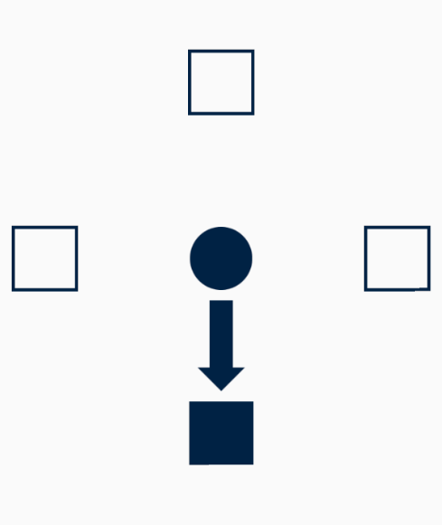

Slide 4
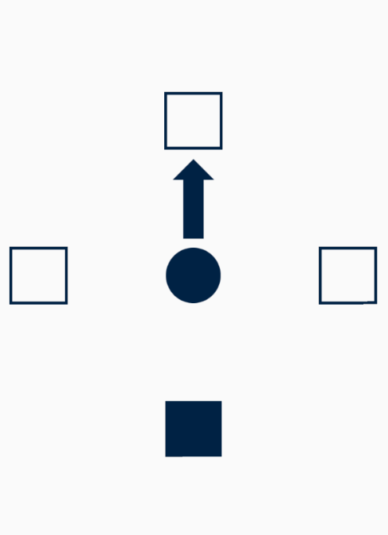

Slide 5
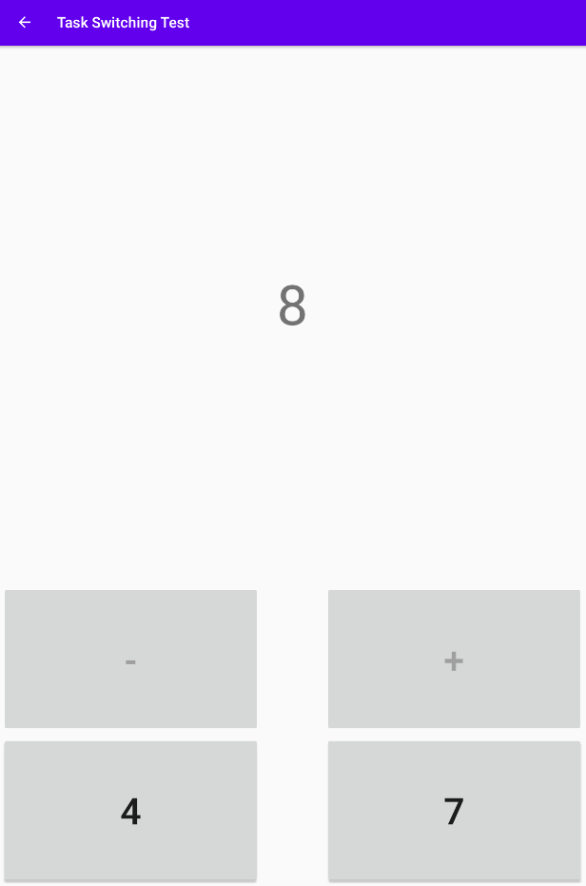

Slide 6
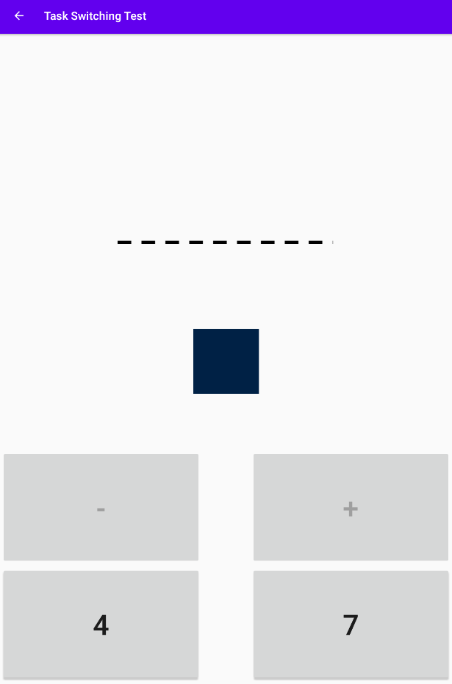

Slide 7
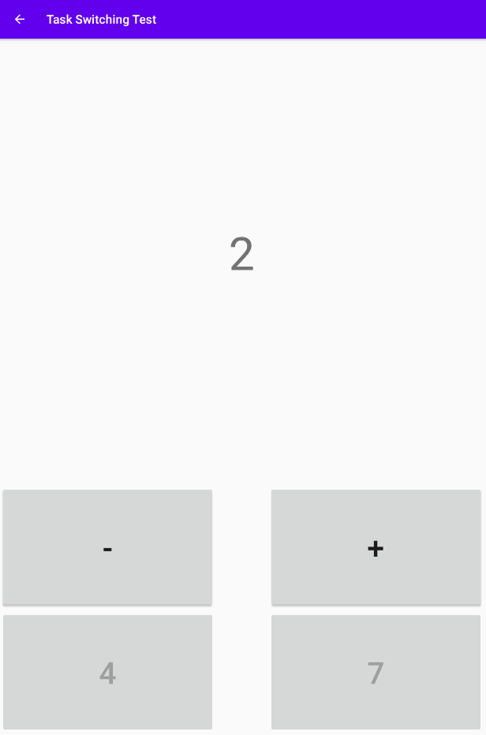

Slide 8
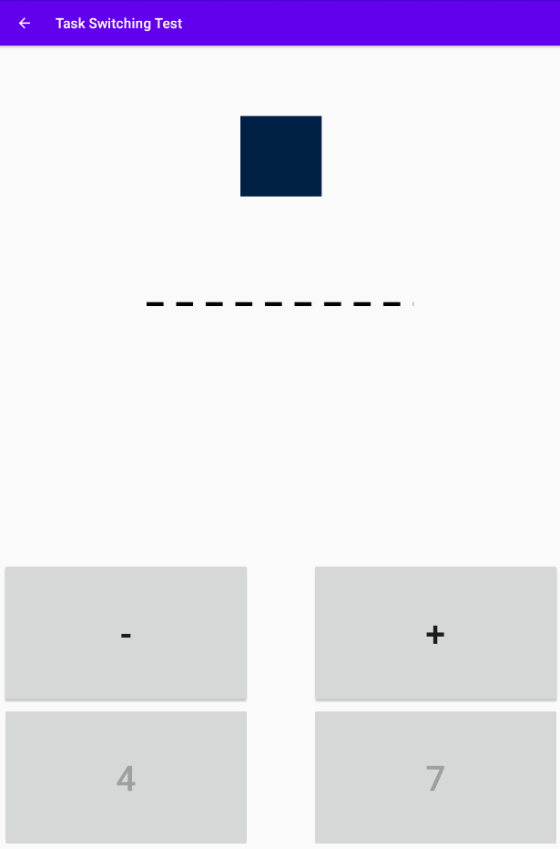

Slide 9
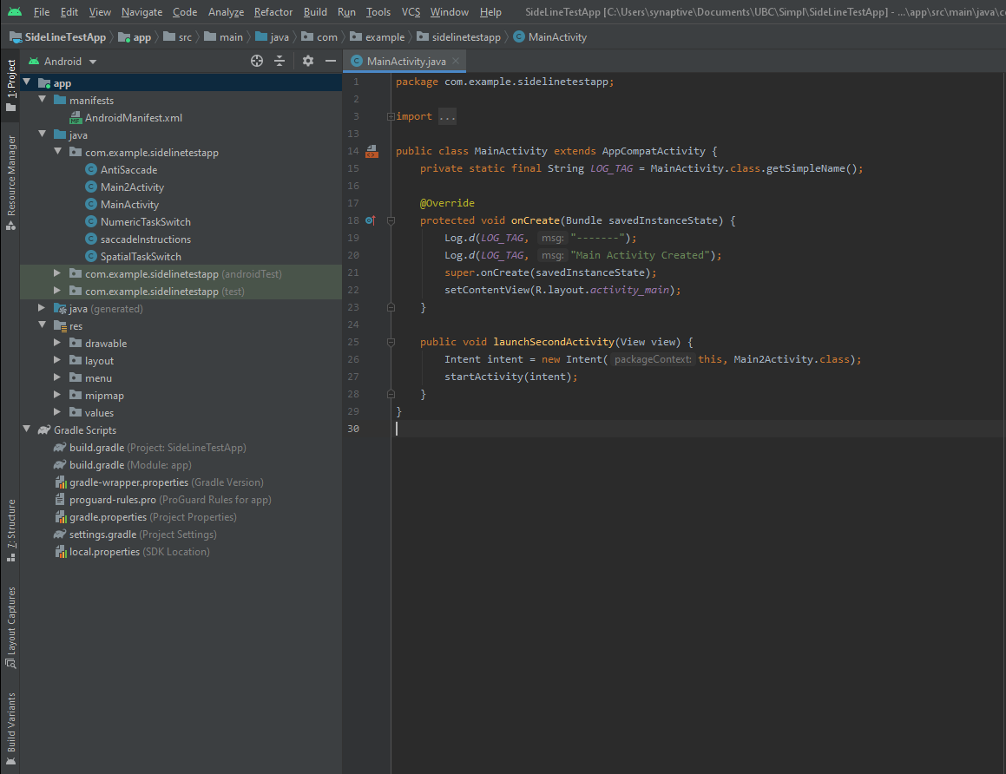
Manifest File
Java/Kotlin Files
Resource Files
Gradle Scripts

Slide 10
Activity 1
Activity 2
Activity 3
TextView
TextView
TextView
ImageView
Intent
TextView
2
Intent
TextView
3
LoginView
Button
ImageView
Button

Slide 11
Login Activity
Intent
Home Page Activity
Login Button

